Slide 1
Sprint 66 Show and Tell 29 January 2025
C Squad
Digital Team

Slide 2
Sprint goal
Progress work started

Slide 3
Alternate provision case management My activities - Customer Contact

Slide 4
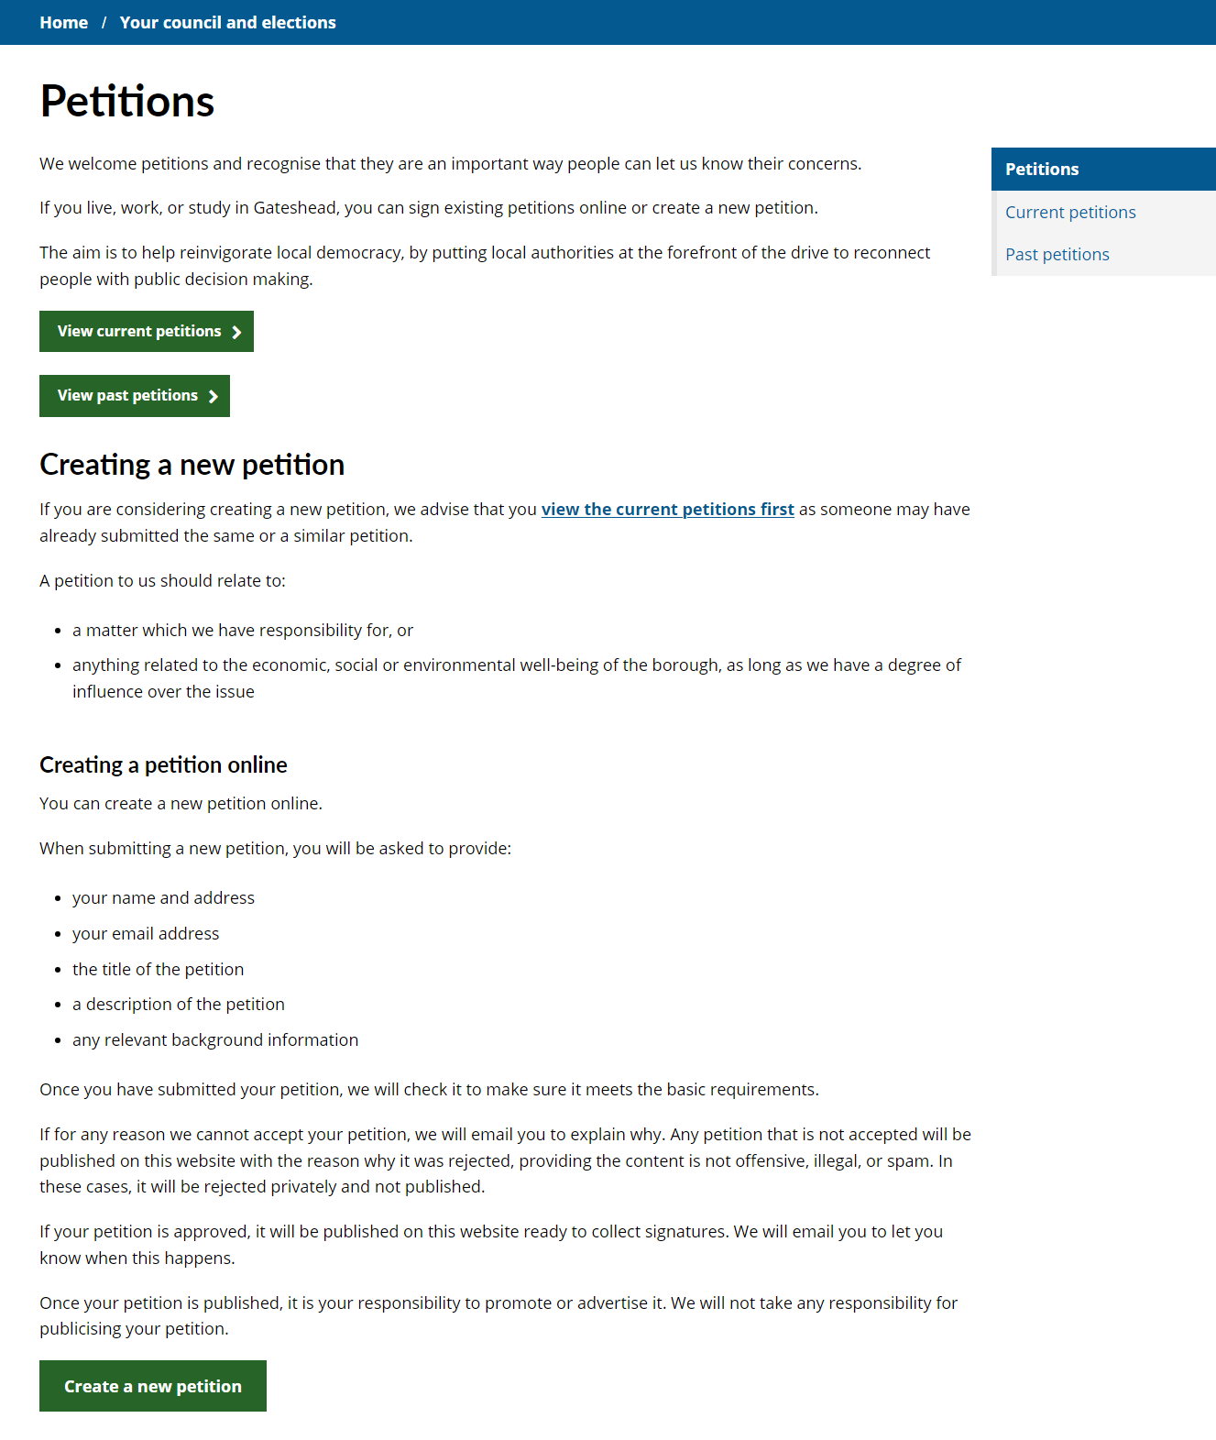
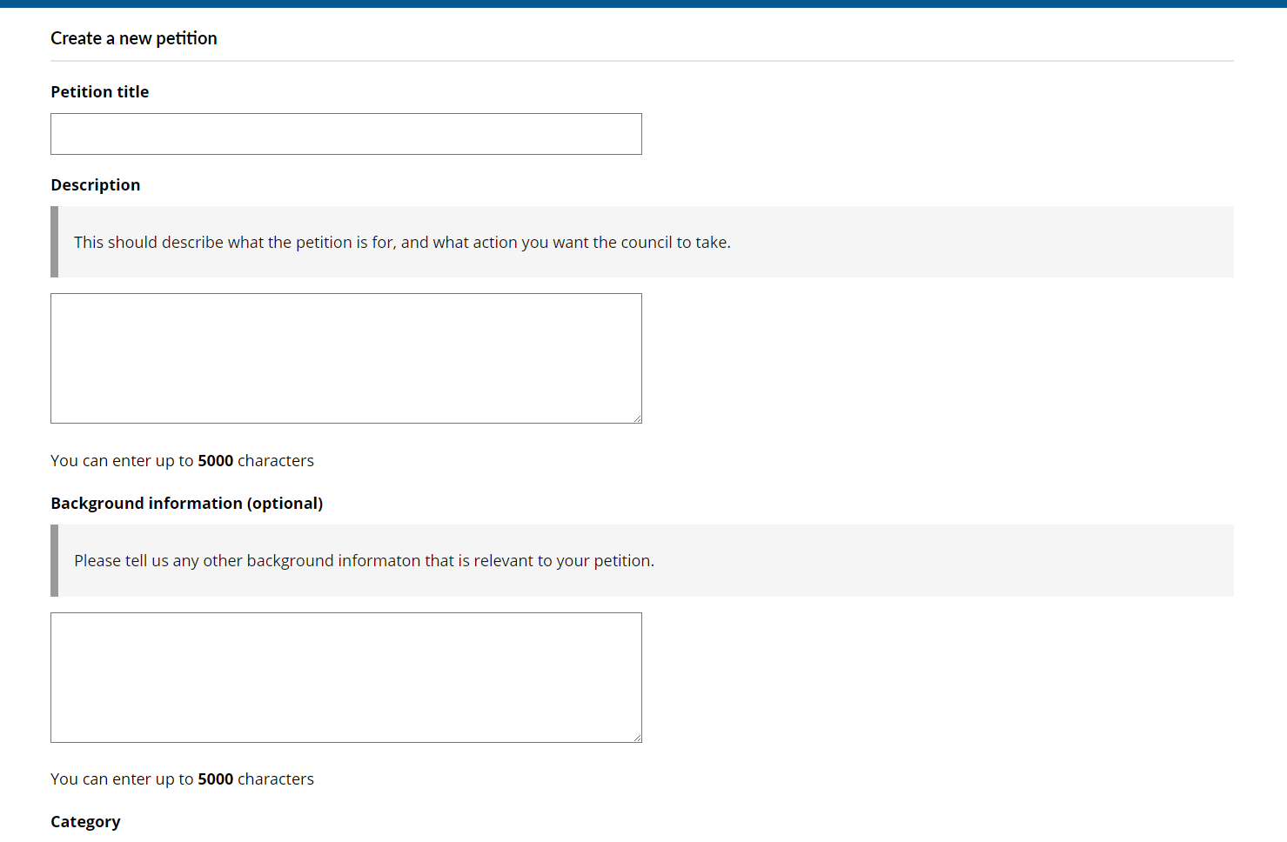
New online petitions form and updated content live
New online petitions form to replace the previous version on the old consultation database
Content also updated
www.gateshead.gov.uk/petitions
Corporate

Slide 5
Cyber Attack – form and case management Cyber attack - intranet form Cyber attack - case management

Slide 6
Appeal a school place Appeal a school place

Slide 7
Public health and wellbeing

Slide 8
Content review for cost of living pages
Request to review and improve content on the website relating to cost of living, particularly relating to search on gateshead.gov.uk.
Content reviewed and improved - Poverty pages.pptx
Public health and wellbeing

Slide 9
Gateshead Cultural Education Partnership website
Gateshead Council are the lead organisation for the Gateshead Cultural Education Partnership.
Request to develop a website for the partnership to promote ongoing cultural projects and to encourage cultural organisations to join the partnership and for schools to become ambassadors.
Developed a basic wireframe of the website to be branded as ‘Shape’ for David to use to develop a prototype in Figma before building the site ahead of end of March deadline.
Community health and wellbeing

Slide 10
NewcastleGateshead Local Plan holding page website
Newcastle and Gateshead councils are preparing a joint local plan.
Event to be held on 5 February 2025
Need a web presence for the event
No branding currently exists. Only the invite that Graphics prepared for the event.
Created a holding page based on the invite
Added a simple contact form and mailchimp sign up
NewcastleGateshead Local Plan

Slide 11
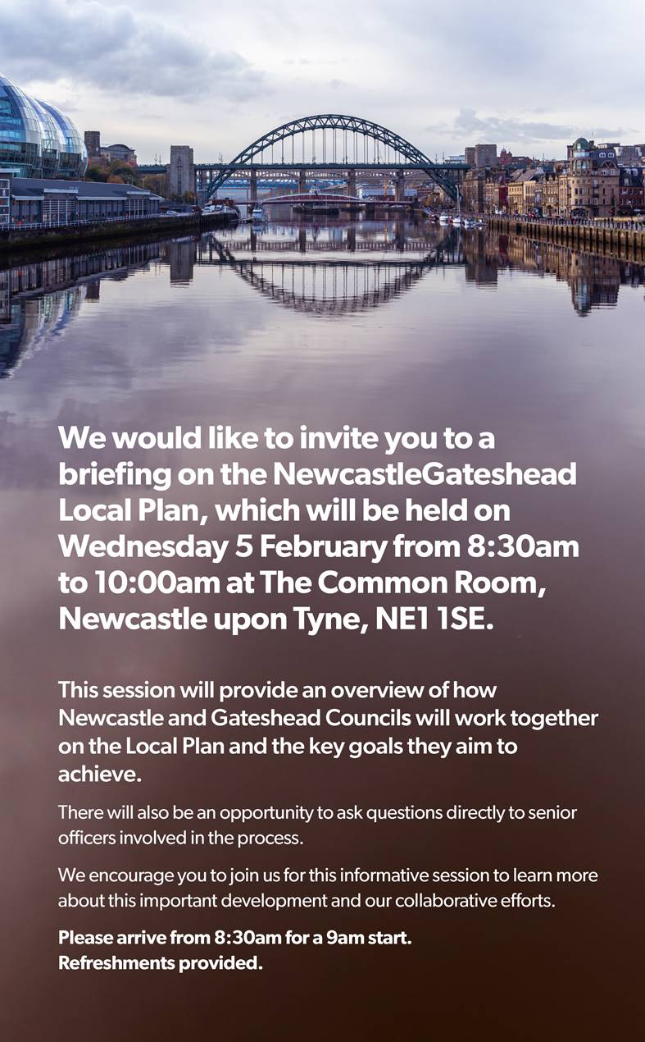
NewcastleGateshead Local Plan holding page website
Invite created by Graphics
NewcastleGateshead Local Plan

Slide 12
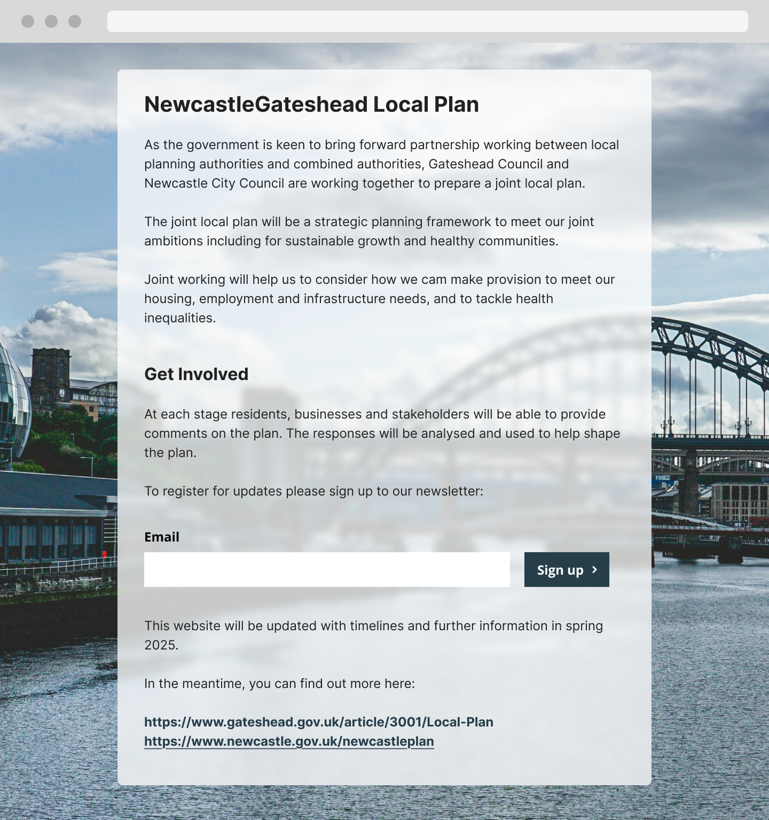
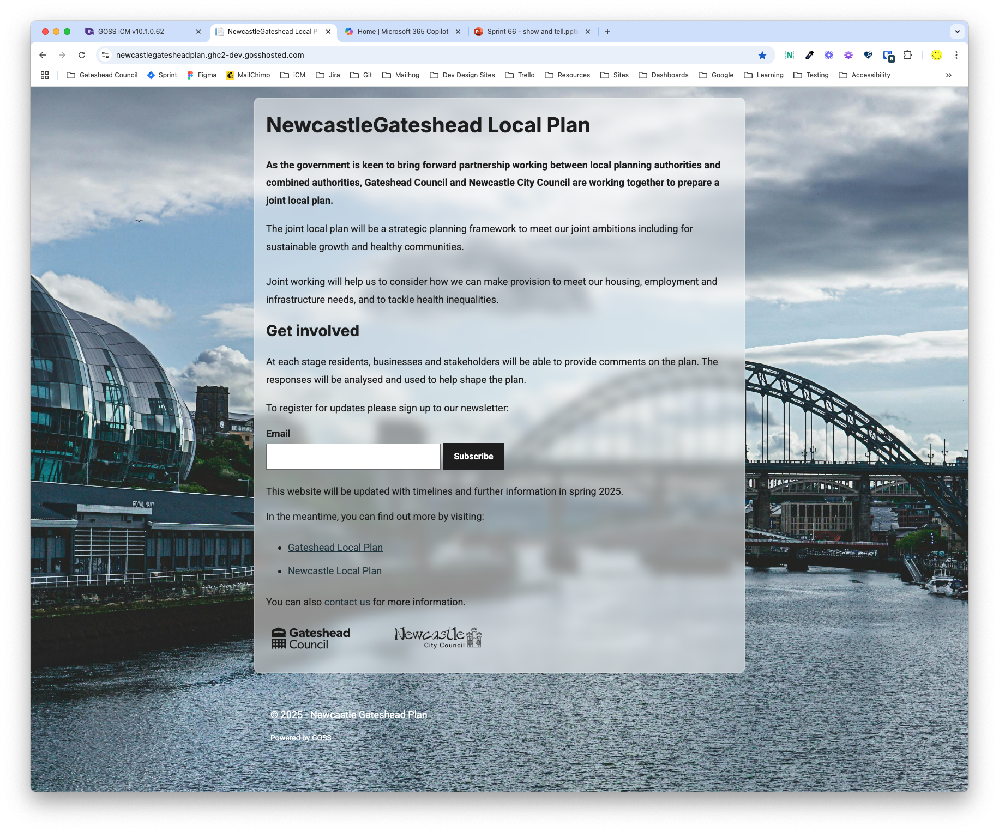
NewcastleGateshead Local Plan holding page website
Figma
Dev
https://newcastlegatesheadplan.ghc2-dev.gosshosted.com/
NewcastleGateshead Local Plan

Slide 13
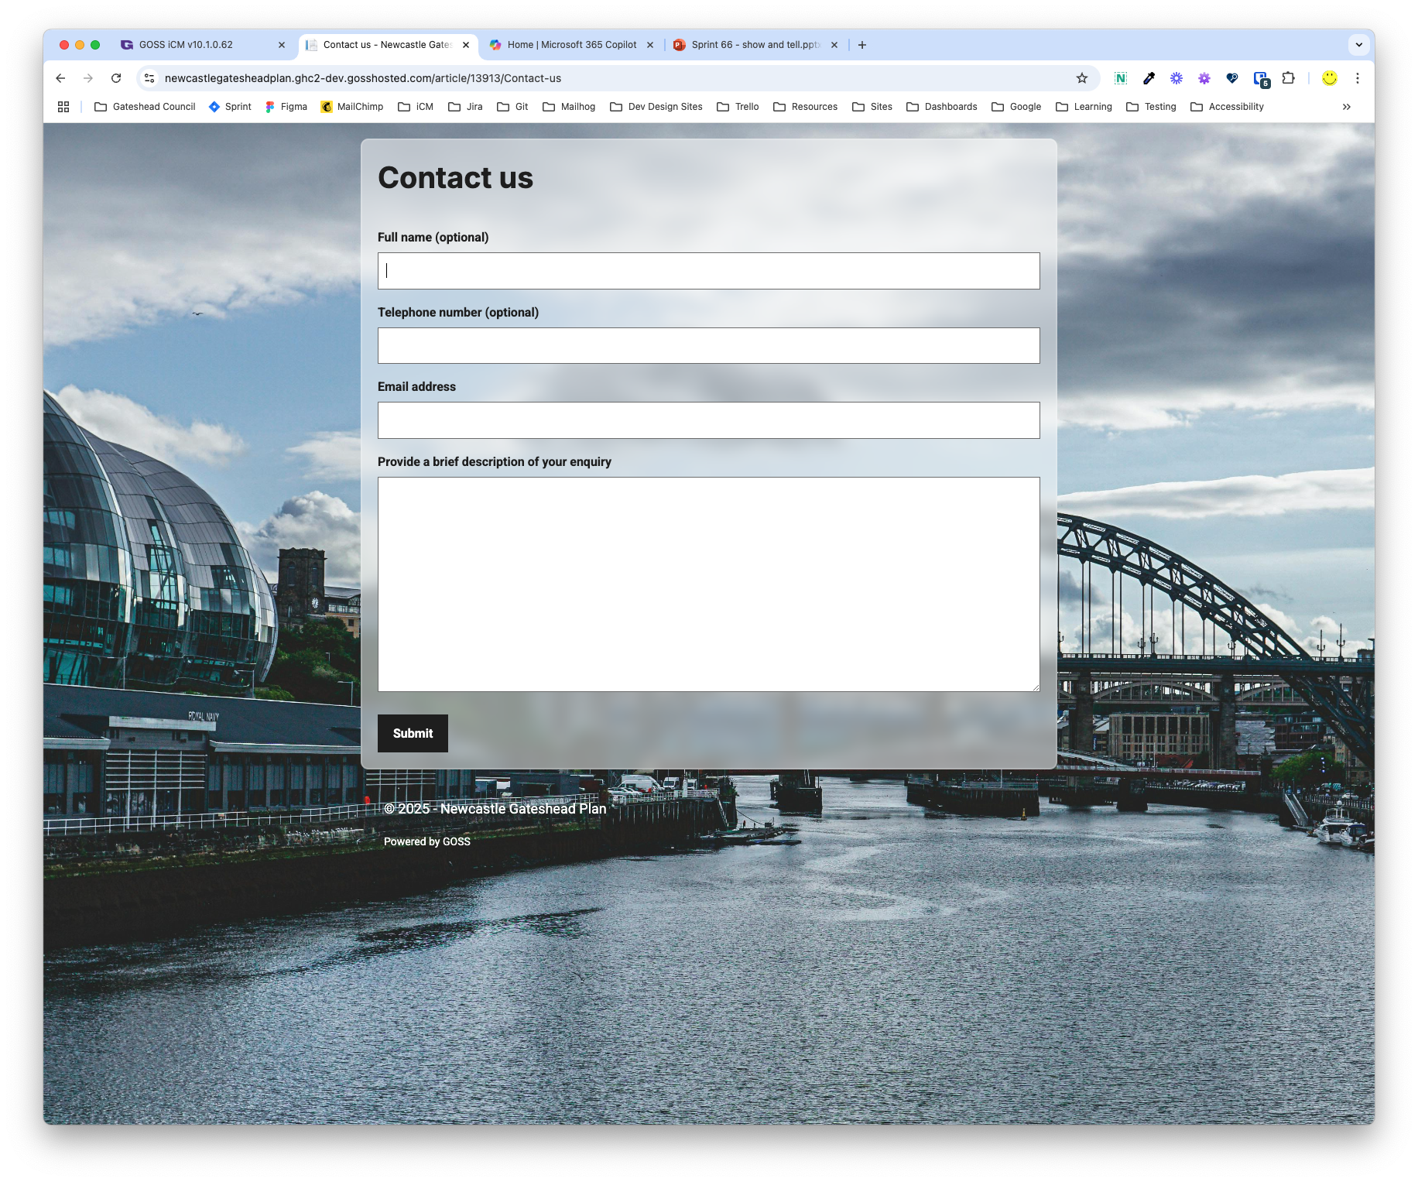
NewcastleGateshead Local Plan holding page website
Simple contact form
https://newcastlegatesheadplan.ghc2-dev.gosshosted.com/
NewcastleGateshead Local Plan

Slide 14
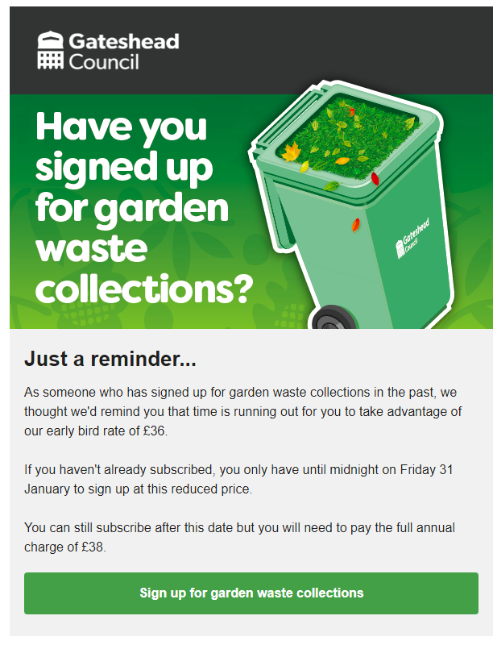
Garden Waste reminder email
Email sent on Monday 27 January to residents that have subscribed to Garden Waste collections in the past but hadn't yet for this year
Reminder to sign up before 1 February to get the reduced price
Resulted in 2518 new sign-ups (90% online, 10% via telephone) to date
Waste services

Slide 15
Coming next……
Learning and skills course directory
Go live Newcastle Gateshead plan
Complete first draft of Direct Payment report
Coming next

Slide 16
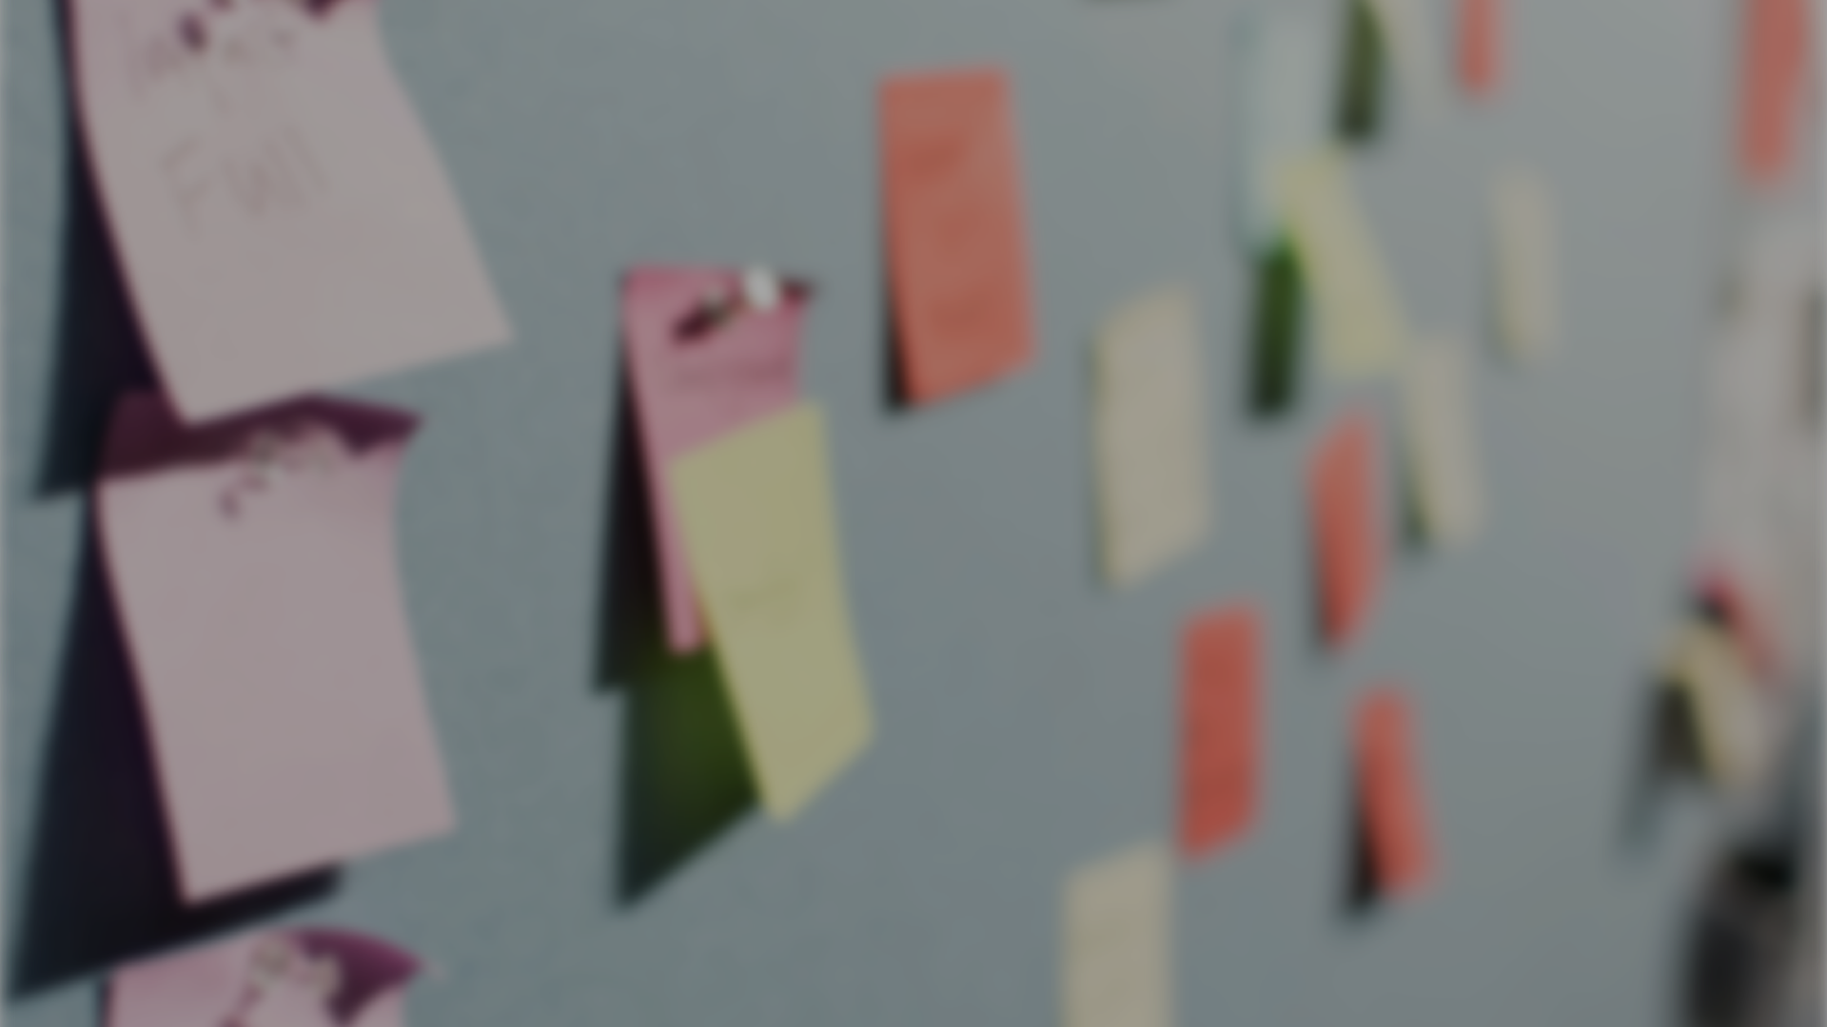
Deployments

Slide 17
Thank you
That's all folks!

