Slide 1
Sprint 67 Show and Tell 5 February 2025
G Squad
Digital Team

Slide 2
Sprint 67
Intro
Sprint Goals
Digital envelope sign up form development
TTRO final amendments
Mobile elevated working platforms
Council Tax – exemption / discount forms

Slide 3
Sprint 67
Development
Mobile elevated working platforms
Demo

Slide 4
Sprint 67
Wireframe
Housing eligibility checker

Slide 5
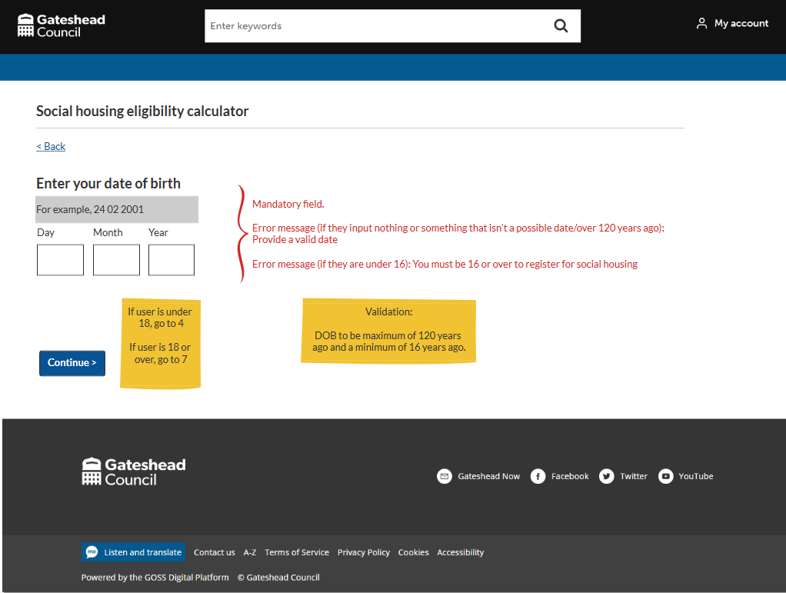
Sprint 67
Wireframe
Housing eligibility checker
Lettings service
Very little data collected
Success = fewer ineligible applications

Slide 6
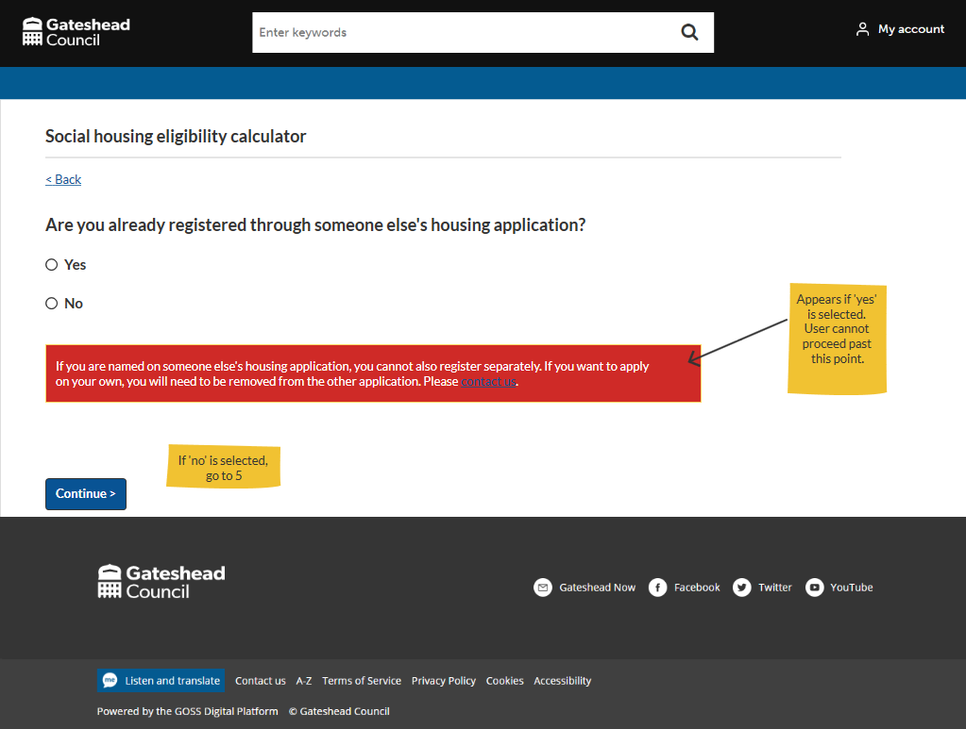
Sprint 67
Wireframe
Housing eligibility checker
Yes/no questions
No submit
RAG rated advice messages
Links to application/more info

Slide 7
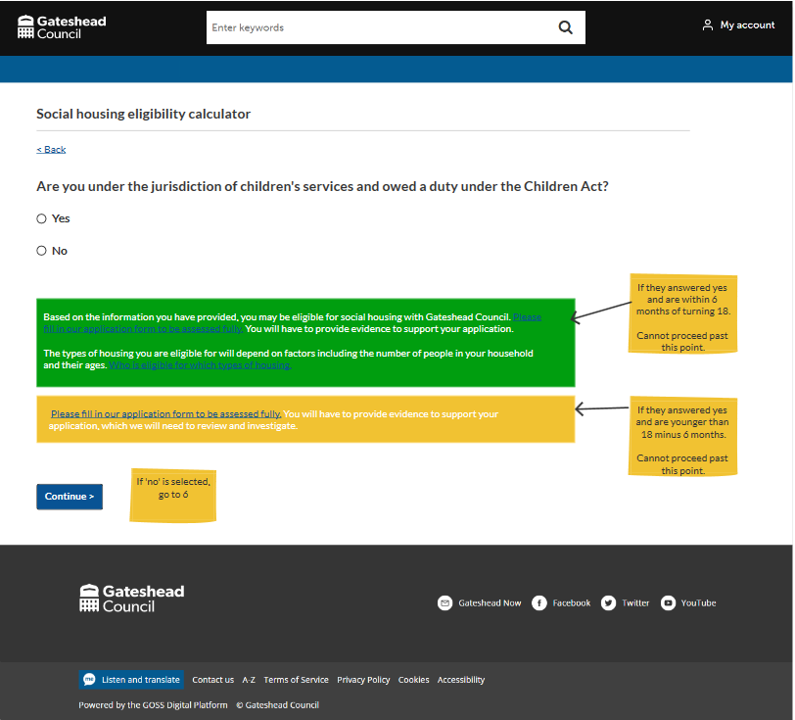
Sprint 67
Wireframe
Housing eligibility checker
Yes/no questions
No submit
RAG rated advice messages
Links to application/more info

Slide 8
Sprint 67
Wireframe
Leader's enquiries

Slide 9
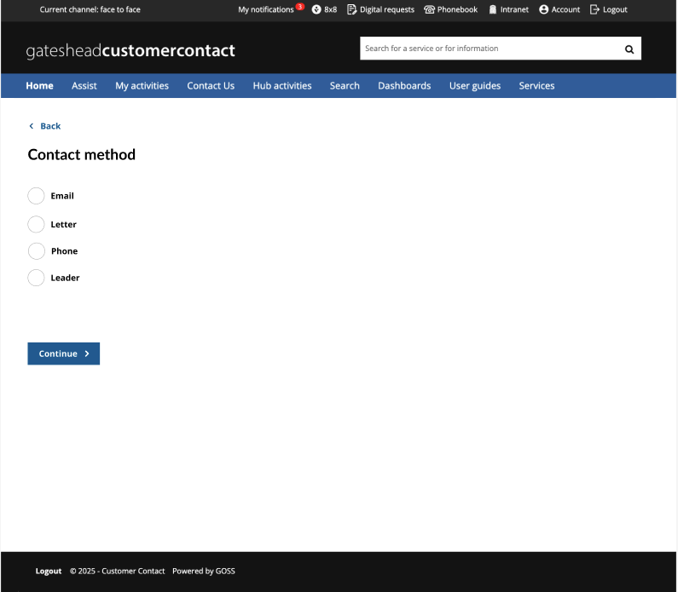
Sprint 67
Wireframe
Leader's enquiries
Internal form
Currently managed in Word/email
Request to use Case Management
Making use of tasks

Slide 10
Sprint 67
Spike
E-Signatures

Slide 11
Sprint 67
Conclusion
What’s next?
Digital envelope / Council Tax e-billing
Council Tax further discount / exemptions
Housing eligibility checker – property type
Minor works private tenure discovery

